Slide 1

Brindavan college of Engineering
Department of Master Of Computer Application
A Project Phase – 2 on
“Fake News Detection”
INTERNAL GUIDE:
PROF. RONGALI YER NAIDU
HOD, Dept of MCA
EXTERNAL GUIDE:
MR. ABHISHEK BELAVI
Managing Director
Ligand Software Solutions

Slide 2
COMPANY PROFILE
The company is situated in Sankeshwar. Ligand Software Solutions is an Indian firm with its headquarters located in Sankeshwar since 2011. A group of technocrats and engineers with extensive backgrounds in the software sector are pushing it. Their combined knowledge and unwavering commitment have allowed the company to quickly grow its clientele throughout the world.The company provides domain + hosting, software development, website promotion, Flash and animation, online and internet marketing, logo design, website development, and website promotion services in India at very reasonable prices while upholding the highest standards of quality and punctuality.

Slide 3

ABOUT PROJECT
Introduction to NLP-Based Fake News Detection In today's digital world, fake news / false information presented as truth as become a major issue. The rapid spread of such misinformation through online platforms can have serious social and political effects. To address this, NLP has research and technological advancement aimed at preventing the false information, branch of artificial intelligence, focuses on enabling computers to understand, interpret, and generate human language. By applying NLP techniques like text analysis, sentiment analysis, and machine learning, we can distinguish between original and false news.

Slide 4
EXISTING SYSTEM
Keyword analysis and statistics.
Basic machine learning models.
Limited language and domain scope.
Manual fact-checking needed.
High false positives challenge.

Slide 5
PROPOSED SYSTEM
Multi-model data analysis.
Real-time, automated detection.
NLP for better context understanding.
Advanced AI models used.
Blockchain for secure verification.

Slide 6
SOFTWARE AND HARDWARE REQUIREMENTS
Software Requirements:
Front end : Bootstrap framework.
Back end : Python.
Operating system : Window 7 or any compatible.
IDE : Visual studio , Jupyter Notebook.
Web framework : Flask.
Libraries : Pandas, Matplotlib,Sklearn,Numpy.

Slide 7
HARDWARE REQUIREMENTS
Hardware Requirements:
Processing Power : Intel Core i3 or higher.
Memory(RAM) : 8 GB to 32GB or more.
Storage : Necessary storage capacity.

Slide 8
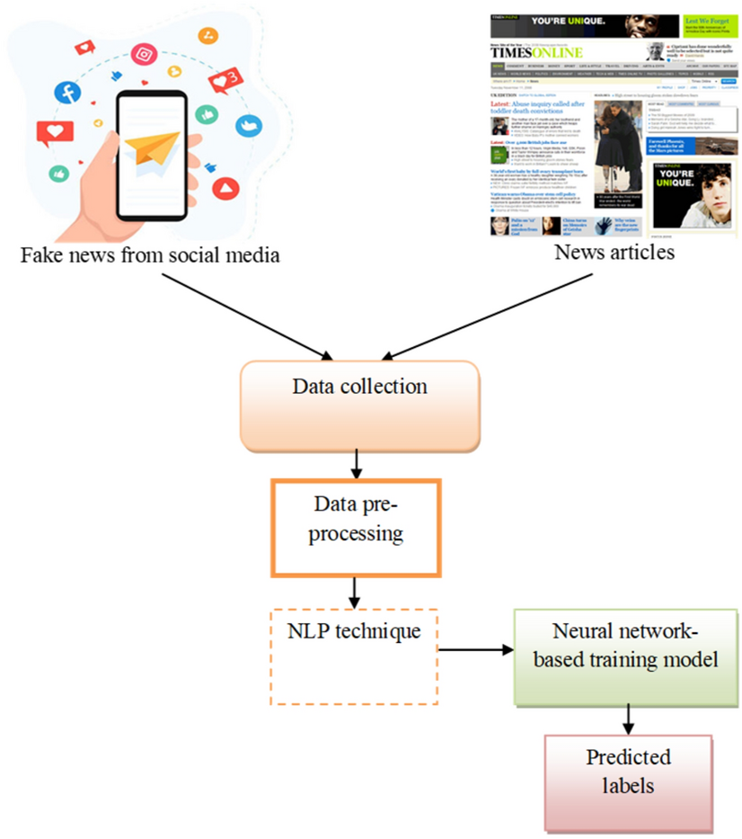
ARCHITECTURE OF PROJECT

Slide 9
FUNCTIONAL REQUIEMENTS
  Content Analysis: Analyze linguistic features.
  Contextual Analysis: Consider social context.
  Early Detection: Catch misinformation promptly.
  Scalability: Handle large volumes efficiently.
  Feedback Loop: Continuously learn and update.

Slide 10
NON FUNCTIONAL REQUIEMENTS
Accuracy: Minimize false results.
Robustness: Resist adversarial attacks.
Privacy: Protect user data.
Latency: Provide timely alerts.
Interpretability: Explain model decisions.

Slide 11
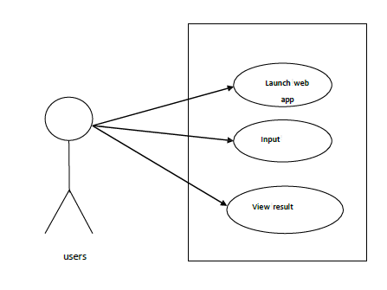
USE CASE DIAGRAM

Slide 12
ALGORITHMS
PASSIVE AGGRESSIVE ALGORITHM:
The Passive-Aggressive Classification algorithm is a machine learning technique commonly used in fake news detection. It's an online learning algorithm, meaning it updates its model as it processes each new data point. When classifying news as real or fake, the algorithm is "passive" if the classification is correct, making minimal changes to the model, and "aggressive" if the classification is incorrect, updating the model significantly to correct the error. This approach allows it to quickly adapt to new patterns in data, making it effective for tasks like real-time fake news detection.

Slide 13
SCREENSHOTS

Slide 14
REAL CLASSIFICATION OFRESULTS

Slide 15
FAKE CLASSIFICATION RESULT

Slide 16
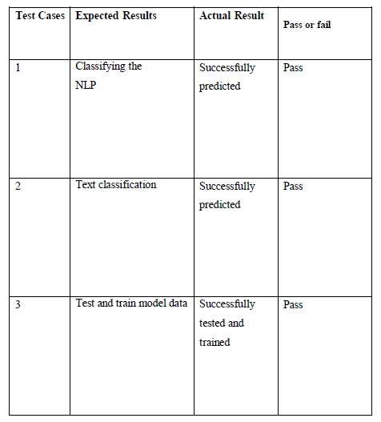
TEST CASES

Slide 17
FUTURE ENHANCMENT
Improving Accuracy and Effectiveness.
Impact on Media Literacy and Democracy.
Improving the models.

Slide 18
CONCLUSION
NLP-based fake news identification has become an essential tool for stopping the spread of false information and ensuring that accurate information is shared.
Combining NLP techniques the use of machine learning models produced promising results in identifying real news articles from false ones.
As we navigate the digital age , AI-powered solutions offer hope in the fight against fake news . stay informed and skeptical!

Slide 19
REFERENCES
1. "Python Crash Course: A Hands-On, Project-Based Introduction to Programming"
Author: Eric Matthews , Publisher: No Starch Press ,Year of Publication: 2015
2. "Automate the Boring Stuff with Python: Practical Programming for Total Beginners"
Author: Al Swigert , Publisher: No Starch Press ,Year of Publication: 2015
3. "Python for Data Analysis" Author: Wes McKinney Publisher: O'Reilly Media .Year of Publication: 2017

Slide 20


